Slide 1
Cloud Enabled Bookstore System
Submitted in the partial fulfillment for the award of the degree of
BACHELOR OF ENGINEERING
IN
BIG DATA ANALYTICS
Submitted by:
Kaustubh Naithani (20BCS4000)
Dhruva Malik (20BCS3976)
Prashant Kumar (20BCS4363)
Under the Supervision of:
Mrs. Geetinder Saini
Department of AIT-CSE
DISCOVER . LEARN . EMPOWER

Slide 2
Outline
Introduction to Project
Problem Formulation
Objectives of the work
Methodology used
Results and Outputs
Conclusion
Future Scope
References

Slide 3
Introduction to Project
A cloud-enabled bookstore system is a software that uses cloud computing to store and process data on remote servers for better efficiency.
It includes components like online store, inventory management, order processing, customer management, analytics, and reporting.
The online store component allows customers to browse and purchase books online.
The inventory management component helps store owners keep track of their stock levels and make informed purchasing decisions.
This system offers scalability, flexibility, and accessibility to the bookstore

Slide 4
Problem Formulation
Create a user-friendly platform that allows customers to browse, purchase, and receive books online easily.
Offer a variety of payment options to customers that are secure and compliant with relevant security standards.
Provide bookstore owners with a dashboard to manage inventory, orders, and shipments easily.
Ensure that the system can handle a large number of users and transactions without performance issues.
Maintain system reliability to minimize downtime and provide uninterrupted service to customers.

Slide 5
Problem Formulation
Implement robust security measures to protect customer data and transactions.
Enhance the user experience with personalized recommendations, easy navigation, and seamless checkout.
Use targeted promotions and discounts based on customer history to increase sales.
Continuously monitor and update the system to ensure it remains secure, reliable, and efficient.
Adhere to industry standards such as PCI DSS, GDPR, and CCPA to maintain data protection and compliance.

Slide 6
Objectives of the Work
The aim of the proposed work is to develop a cloud-enabled bookstore system by achieving the following objectives:
To create a user-friendly platform with personalized recommendations, real-time inventory management, and easy payment options for customers.
To improve bookstore efficiency through automated inventory management and seamless communication between departments.
To expand the bookstore's reach and reduce costs through cloud infrastructure and security measures.
To enable data analysis for customer insights, improve the customer experience, and increase sales.

Slide 7
Methodology used
Gathering requirements: Collecting system requirements from users, surveys, and market research, focusing on features such as online book browsing, inventory management, personalized recommendations, and payment options.
System design: Planning how the system will be built by designing the database schema, user interface, and cloud infrastructure.
Development: Building the system using appropriate programming languages and technologies, such as databases, web technologies, and cloud services.
Testing: Thoroughly testing the system for bugs, errors, and performance issues through unit, integration, and system testing.
Deployment: Configuring and deploying the system to a cloud platform, such as AWS or Azure, including setting up the database and application code.
Maintenance: Regularly updating, securing, and backing up the system, and making changes to existing features based on user feedback and market changes.

Slide 8
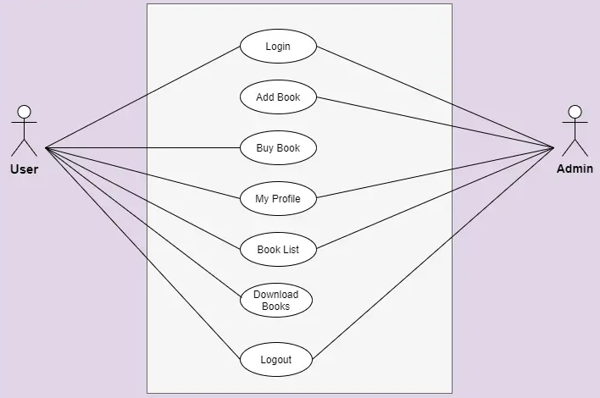
Use Case Diagram of Cloud Enabled Bookstore System

Slide 9
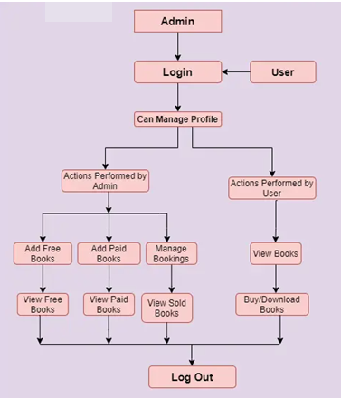
DFD Diagram of Cloud Enabled Bookstore System

Slide 10
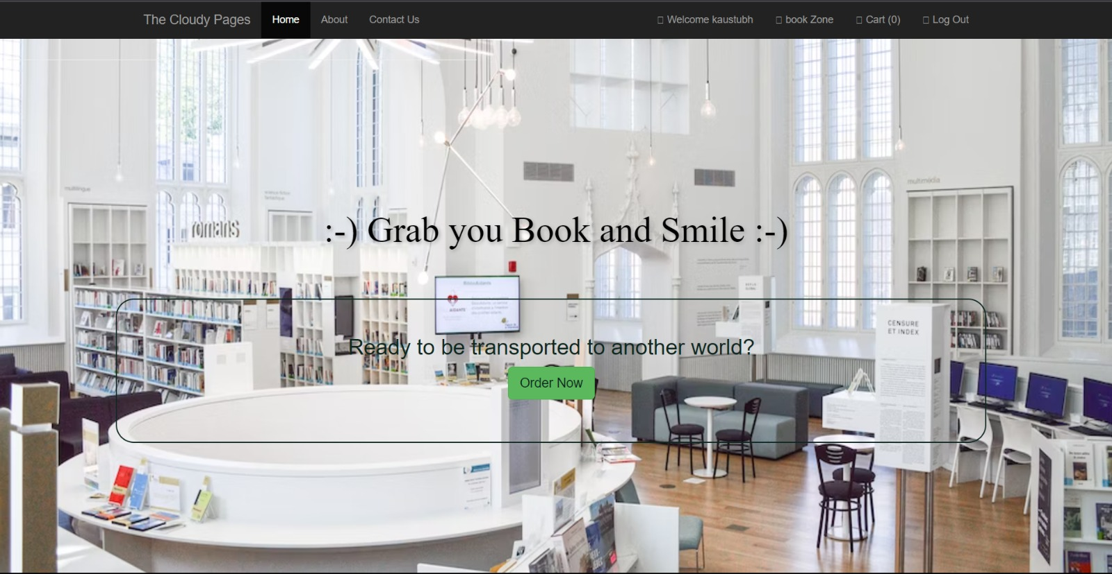
Results and Outputs
HOME PAGE

Slide 11
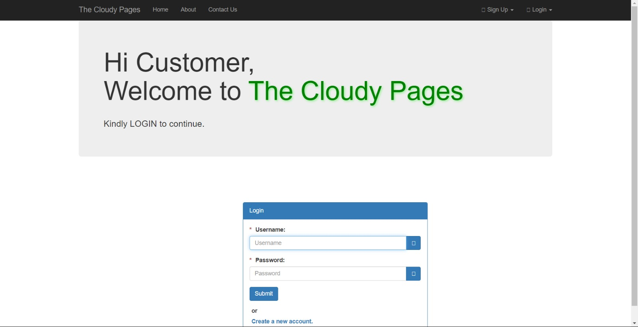
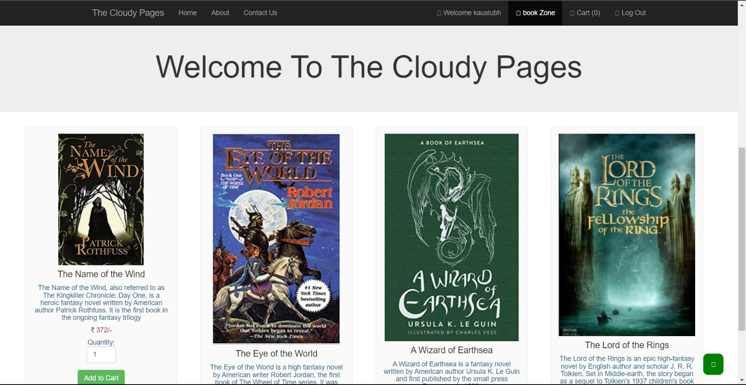
Welcome Page
Customer Login Page

Slide 12
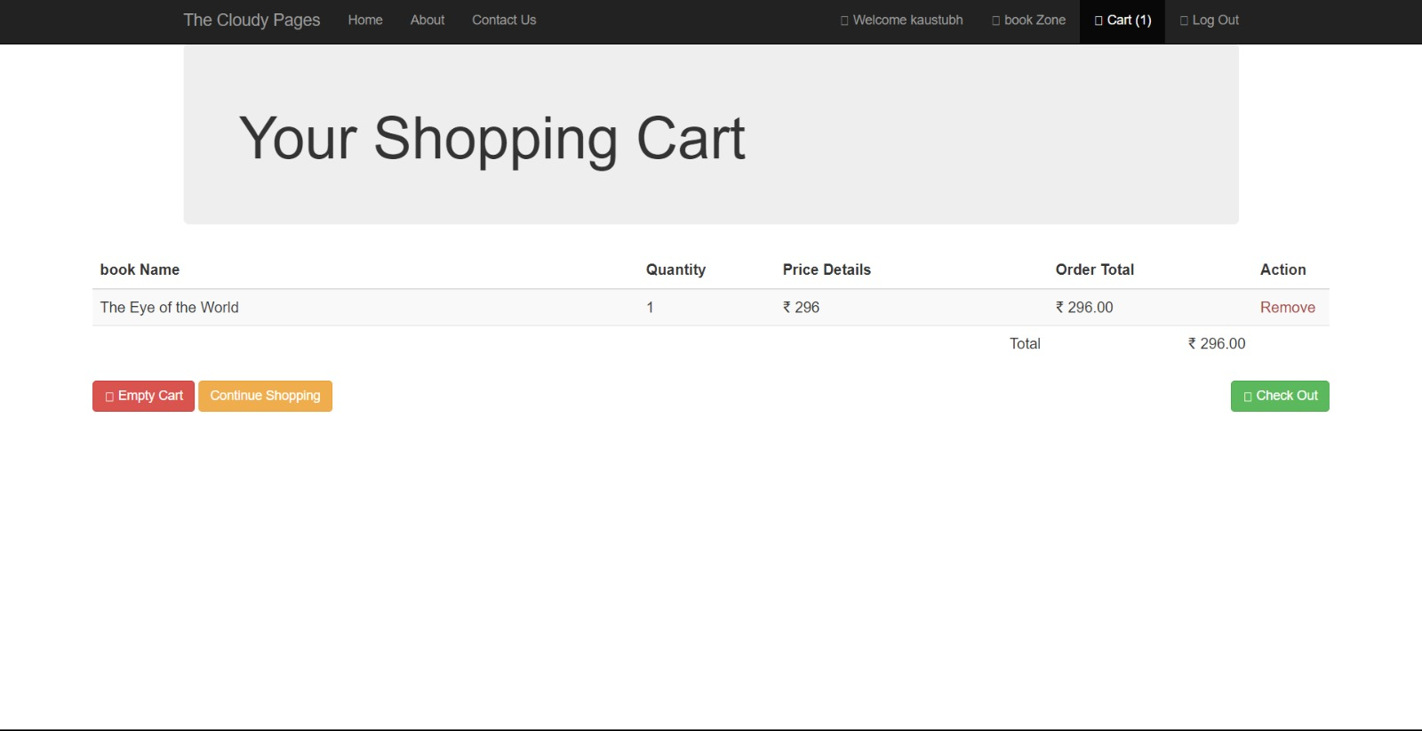
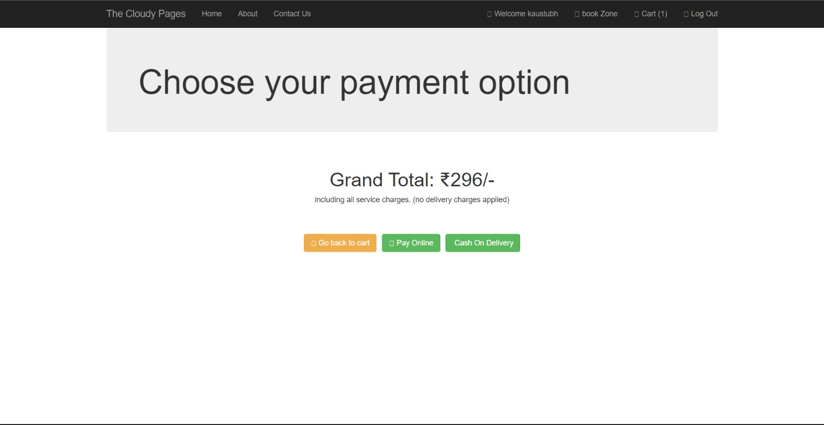
Shopping Cart Page
Payment Page

Slide 13
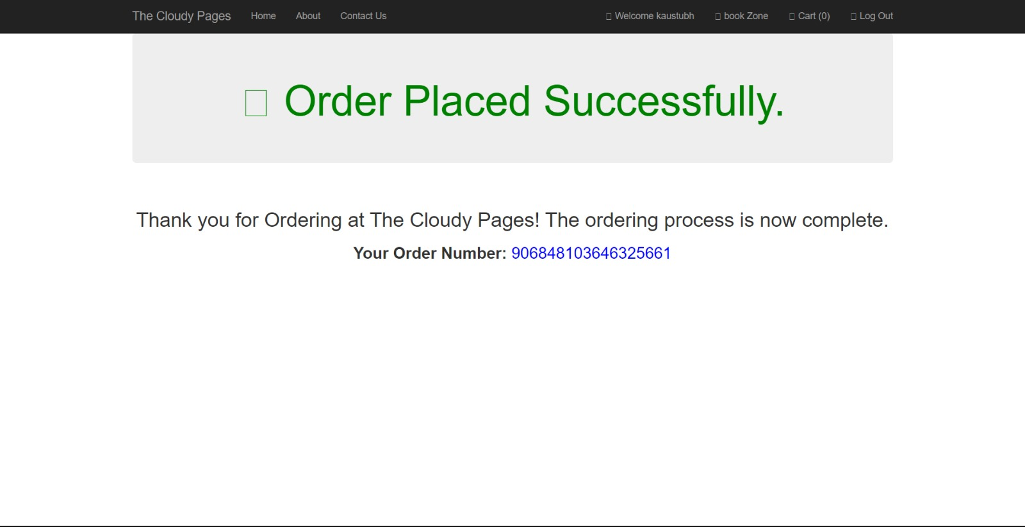
Confirmation of Order Placed Page.

Slide 14
Conclusion
In conclusion, a cloud-enabled bookstore system is a modern solution to streamline bookstore operations, enhance the customer experience, and increase reach and visibility. The system aims to provide a user-friendly platform for customers to browse and purchase books online, automate inventory management, and improve communication between different departments. By leveraging cloud infrastructure, the system can reduce costs associated with maintaining a physical storefront while enhancing security and reliability. Additionally, the system can collect and analyze customer data to gain insights into customer behavior and preferences, enabling data-driven decision making. The methodology for developing such a system involves requirements gathering, system design, development, testing, deployment, and maintenance. Overall, a cloud-enabled bookstore system is a valuable investment for bookstores looking to stay competitive in today's digital age.

Slide 15
Future Scope
The future scope of a Cloud Enabled Bookstore System is quite vast and promising. Here are some potential areas where the system can be further developed and enhanced:
Artificial Intelligence (AI) and Machine Learning (ML) can be integrated into the system to provide personalized book recommendations and improve the overall customer experience.
The system can be expanded to include more types of products such as ebooks, audiobooks, and other digital media.
The system can be further optimized to provide faster and more seamless online payments and checkout processes.
Analytics and big data can be utilized to gain insights into customer behavior and preferences, allowing the system to continuously adapt and improve.

Slide 16
References
Zakaria Issa Saleh, Ahmad Shaher Mashhour, “The Impact of E-Books on the Printed Books: E-Books Popularity, Growth and Future” 2015 Fifth International Conference on e-Learning.
“Online Book Store using Cloud Infrastructure” Tanzil Petkar Muddsar Sayed Ashutosh Waghmare Nikita Bawage Mrs. Sarita Patil , IJSRD - International Journal for Scientific Research & Development 2020.
"Application of the Task-Technology Fit Model to Structure and Evaluate the Adoption of E-Books by Academics" Article in Journal of the American Society for Information Science and Technology · January 2013
The Impact of E-Books on the Printed Books: E-Books Popularity, Growth and Future IEEE (Fifth International Conference on e-Learning) 2015.
Cloud Computing: a Perspective Study Article in New Generation Computing · April 2010.
Adoption of e-book among college students: The perspective of an integrated TAM Chang-Hyun Jin 2014.
A Cloud-Based Distributed Platform for Secured EPUB EBOOK Contents Yunus Parvej Faniband, Iskandar Ishak, Fatimah Sidi, Marzanah A. Jabar 2020.

